Slide 1
Filtering and Summary Statistics
Jonathan Zouari and Ayelet Blass

Slide 2
Data Cleaning (cleaning_data.m)
Steps we conducted in order to clean the data:
Deleted sequences with length<40
Deleted duplicates
Check for any gaps or non numeric values
Deleted fixed sequences
Deleted sequences with only 10 different values
We saved the new sequences as: ‘cleaned_data.mat’

Slide 3
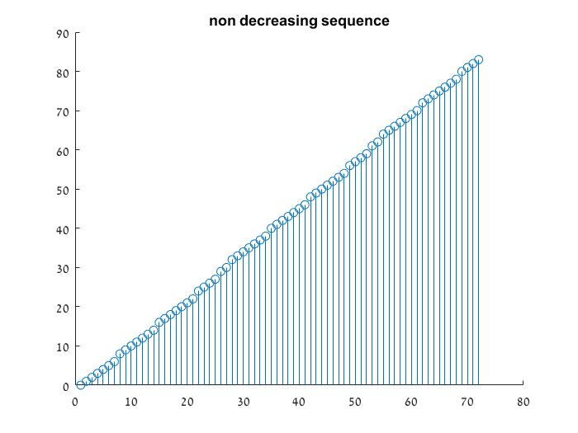
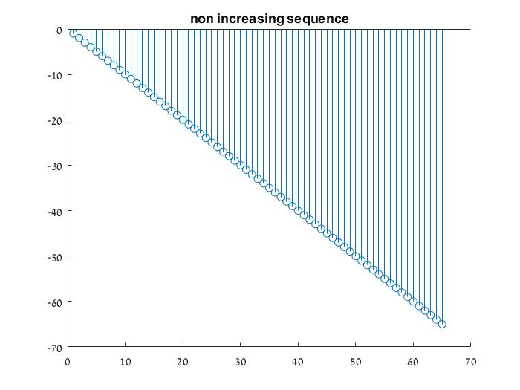
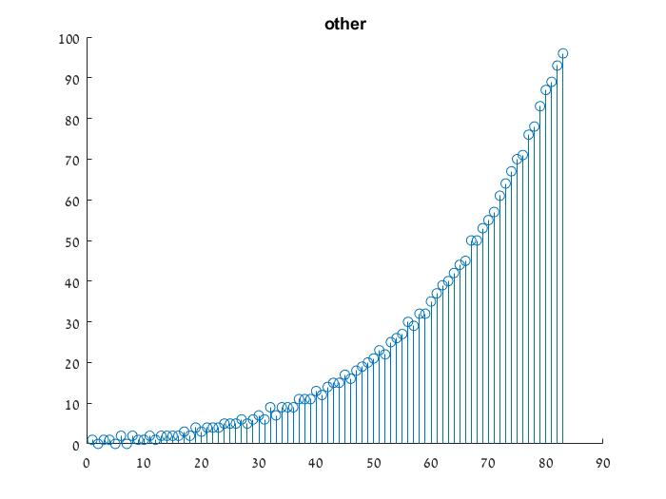
Example Sequences (seq_ex.m)

Slide 4
Simple Characteristics

Slide 5
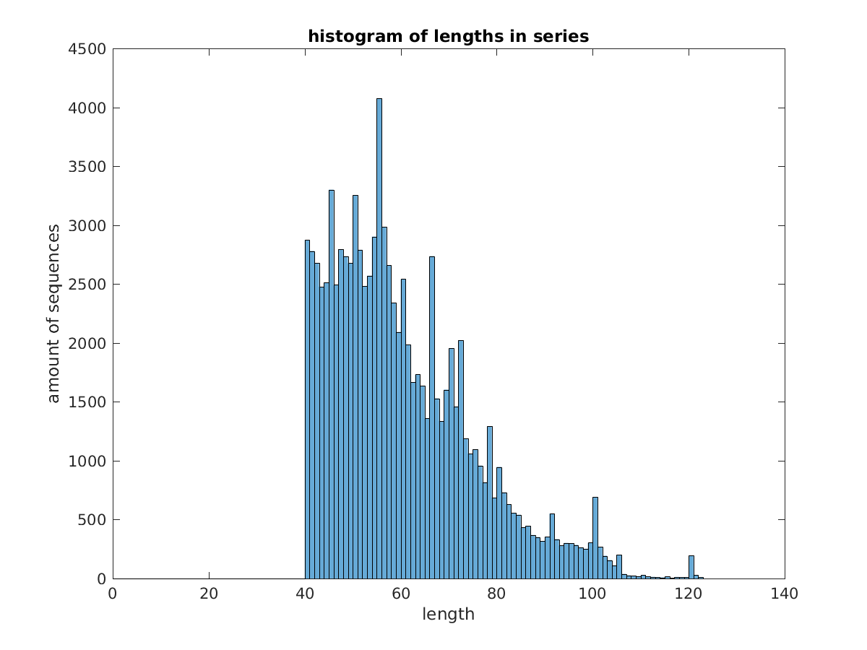
Simple Characteristics(getLengths.m)
Histogram of lengths after filtering.
As we can see the histogram starts
from length 40 as all sequences of
length less than 40 were filtered out

Slide 6
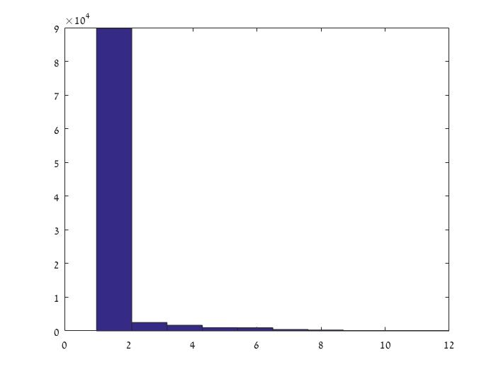
Simple Characteristics (hist_appear.m)
histogram of multiple appearances
We checked for multiple appearances
in each sequence and computed the median
of the occurrences.

Slide 7
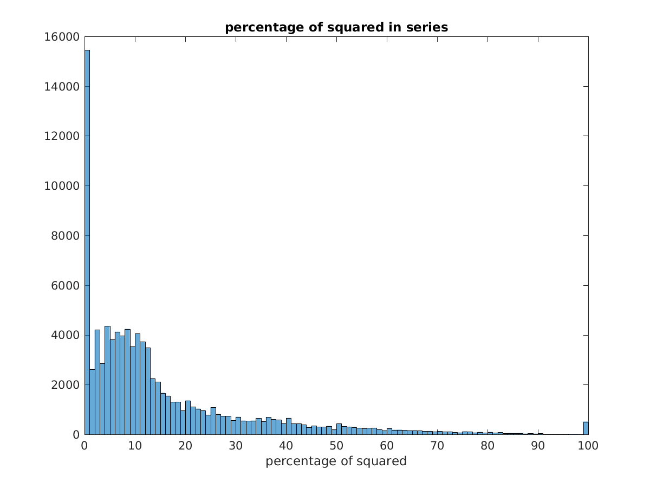
Simple Characteristics (getPercentageSquared.m)
Squared percentage
declines exponentially
small peak at 100%
Notes:
Only non negative numbers could be defined as squared
Peak at 100% are probably sequence of squared numbers or cyclical sequences with squared numbers

Slide 8
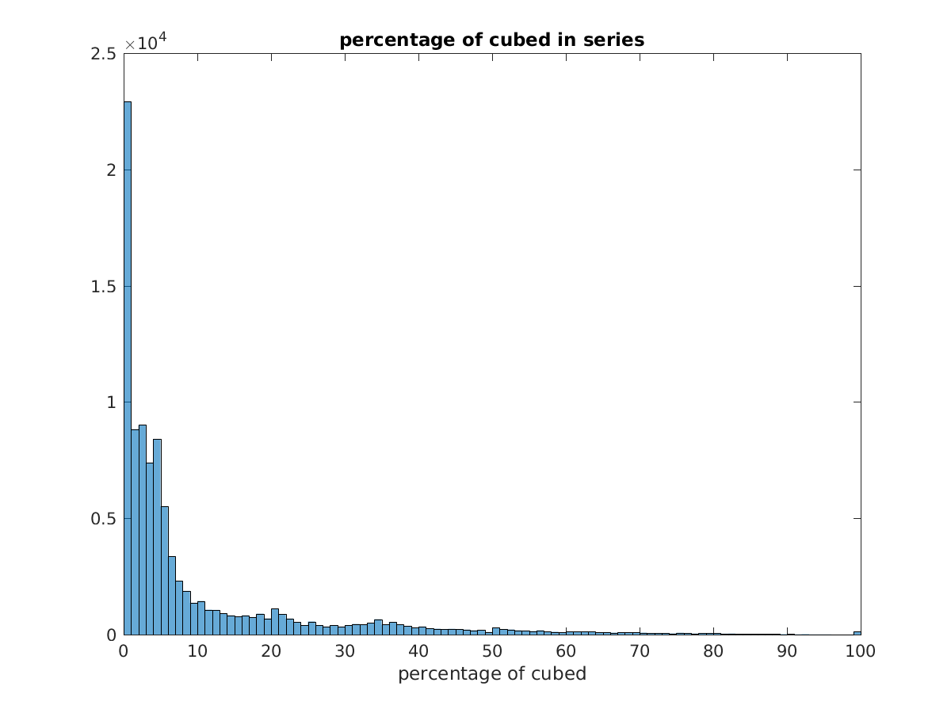
Simple Characteristics (getPercentageCubed.m)
Squared percentage
declines exponentially
smaller peak at 100%
Notes:
Only non negative numbers could be defined as cubed

Slide 9
Simple Characteristics (monoSeq.m)
Monotonic sequences
We split the sequences according to monotonic characteristics. Can be found in our folder.
Non decreasing | Non increasing | Non monotonic
50.42% | 1.7% | 47.88%

Slide 10
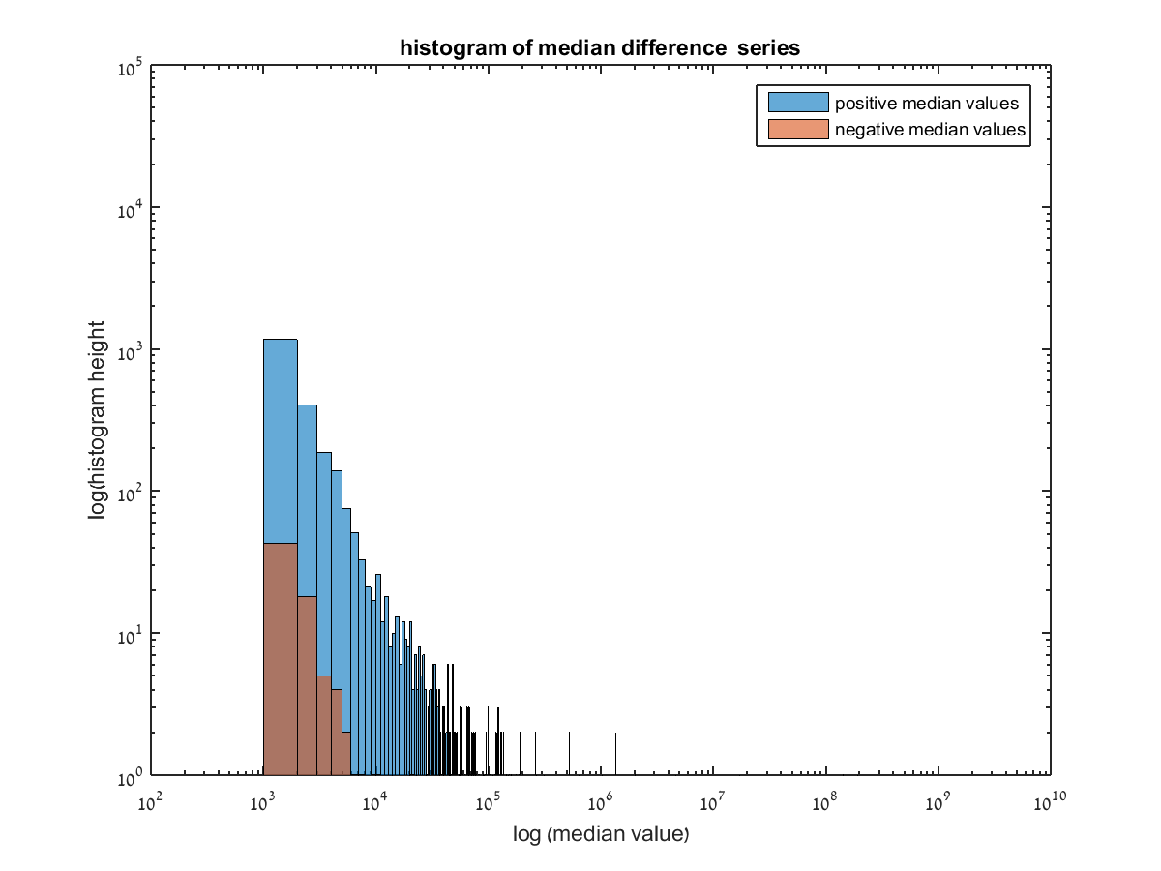
Simple Characteristics (getDifferences.m)
Differences
We calculated the median of the
differences in each sequence
Notes:
Brown represents the sequences where the median was negative. In this graph we took the negative of these medians so we could show it in log scale

Slide 11
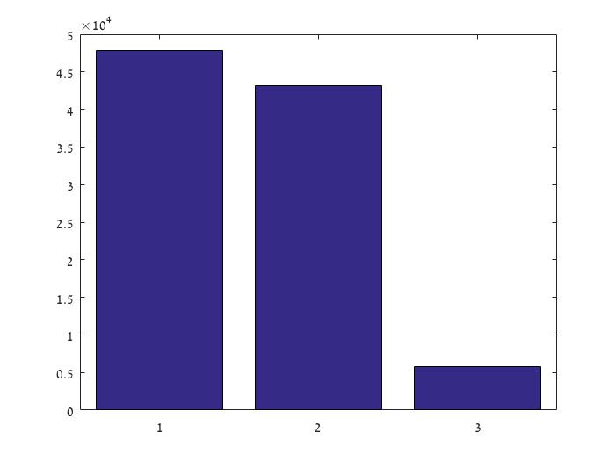
Simple Characteristics (even_odd.m)
Compare number of even and odd
We checked occurrences
of even/odd numbers In each sequence:
odd_occ(Seq) > even_occ(Sequence) (1)
even_occ(Seq) > odd_occ(Seq) (2)
even_occ(Seq) = odd_occ(Seq) (3)
odd>even
even<odd
odd<even
odd=even

Slide 12
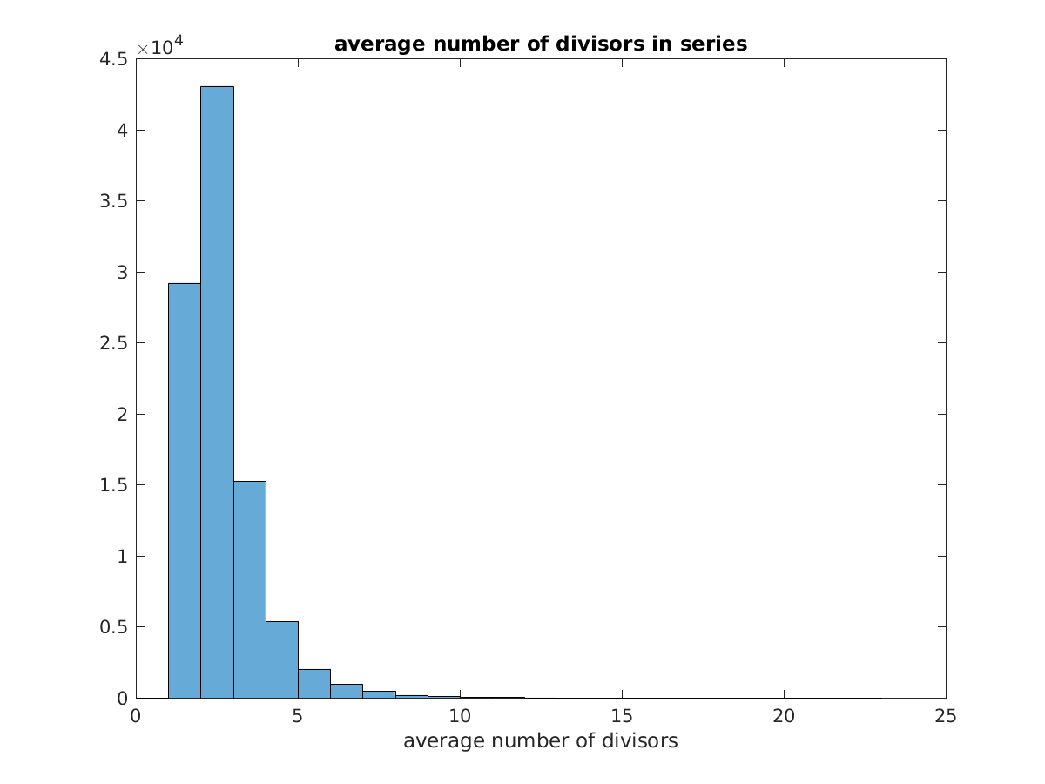
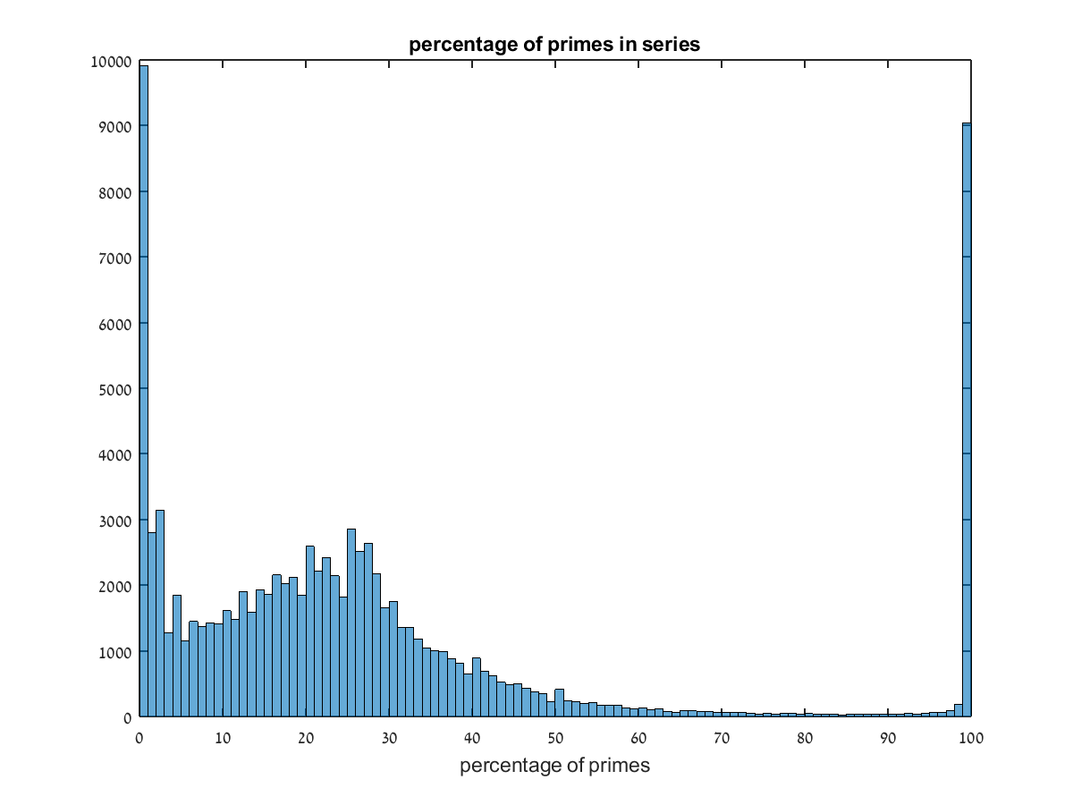
Complex Characteristics(getPrimesPercent.m)
Primes
We calculated percentage of primes
There are 3 peaks
Middle peak at ~25%
Notes:
Only non-negative numbers could be prime.

Slide 13
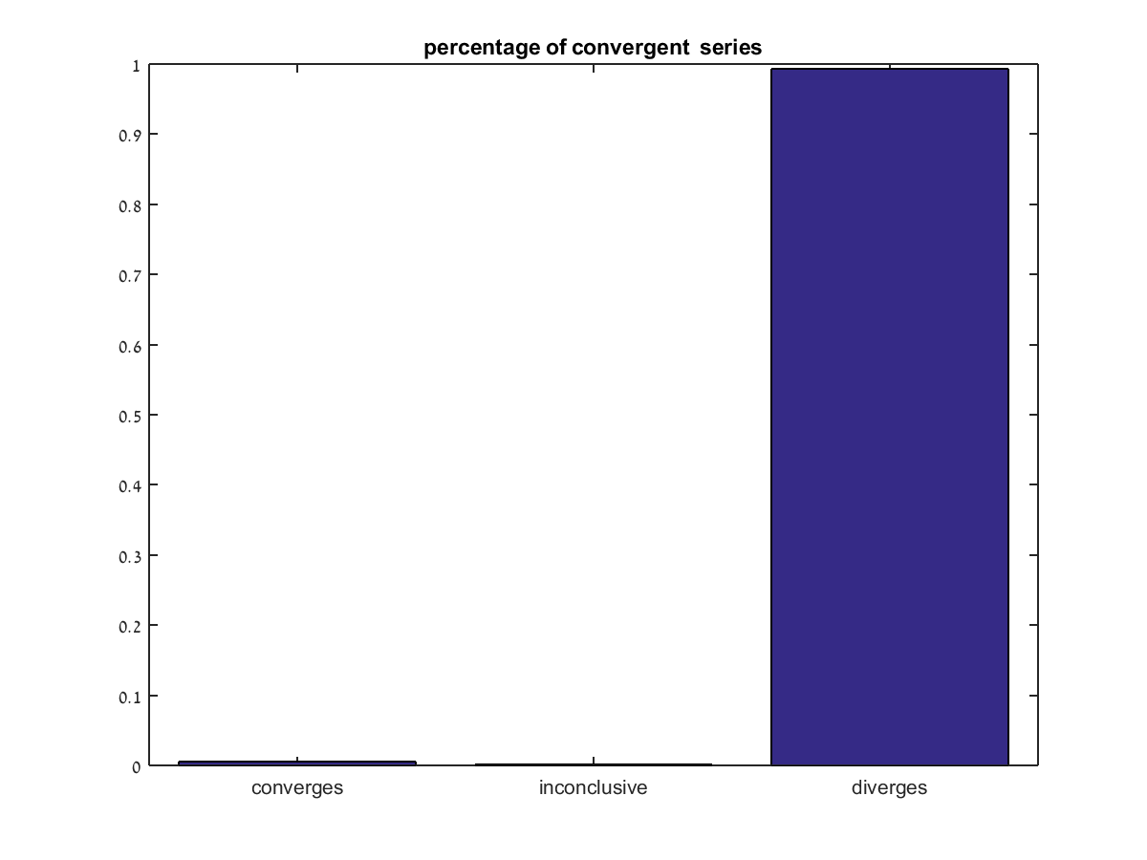
Complex Characteristics(getConverges.m)
Convergence
Convergence is based upon behaviour
of the last 10 numbers in the sequence
We caculate the second order difference
on the absolute value of the integers and
if all are smaller then 0 we define the
sequence as converging
convergence | inconclusive | diverges
16 | 2191 | 94574
Notes:
Since all sequence lengths were in the same order of magnitude (40-123) we took the last 10 numbers in the sequence to define convergence

Slide 14
Complex Characteristics (periodic.m)
Periodic Sequences
We used seqpriod function and didn't find any periodic sequences
Notes:
p = seqperiod(x) returns the integer p that corresponds to the period of the sequence in a vector x. The period p is computed as the minimum length of a subsequence x(1:p) of x that repeats itself continuously every p samples in x

Slide 15
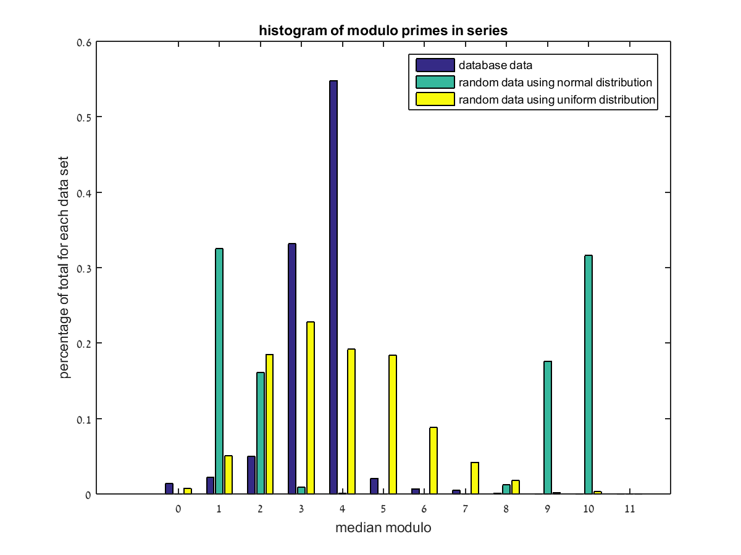
Complex Characteristics (getMedianModulo.m)
medianModulo
We did modulo of the first 10 median
numbers and calculated the median
It seems like the numbers are not in a
uniform or normal distribution

Slide 16
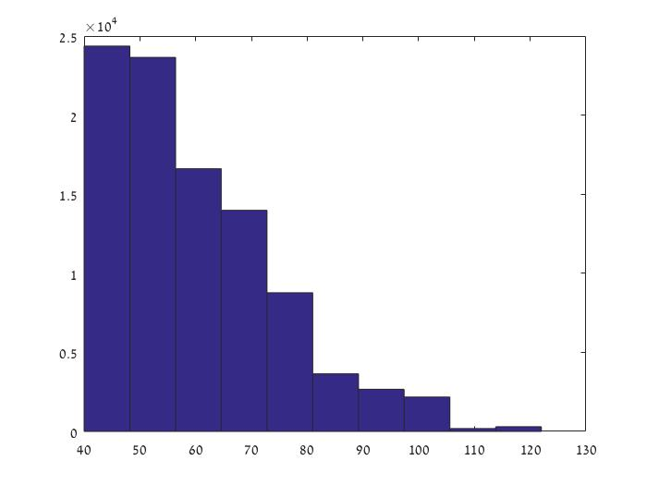
Feature space (primeFacFeatSpace.m)
We looked for a new feature space:
For each seq=(x1,x2,x3,......x40) (we took only seq with length(seq)=40)
factor(xi)=p1*p2*....*pj ∀i∈[1,40]
Compute the med_prime_xi=median(p1,p2,...pj) ∀i∈[1,40]
Xi <- med_prime_xi

Slide 17
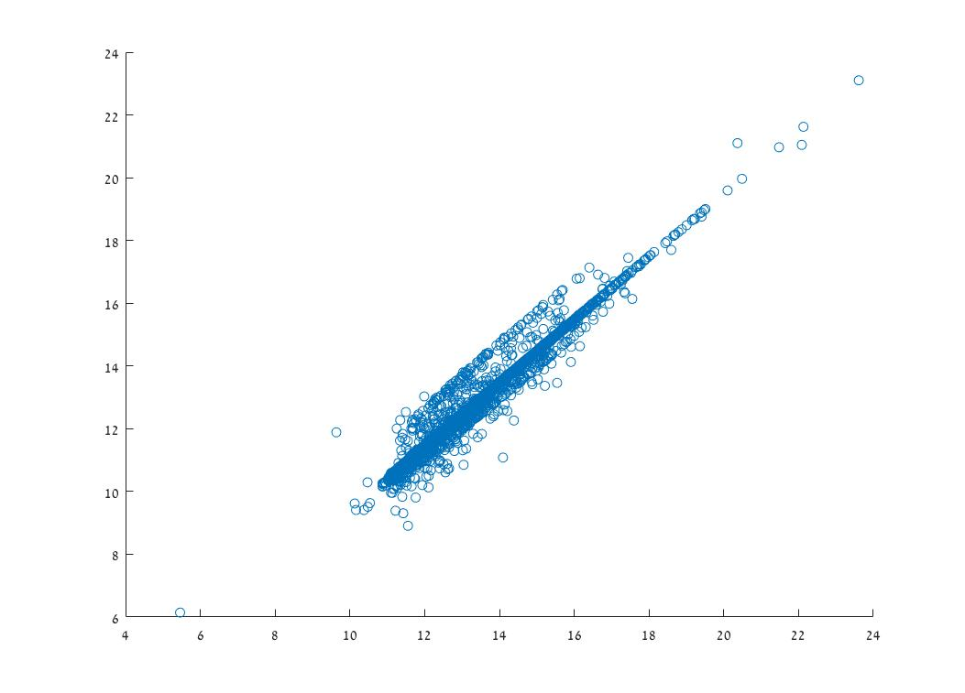
PCA plot (PCA.m)
-Using the feature space we have created, we reduce the dimension space to p=2 using PCA (variance explained = 35%).
- Positive linear correlation

Slide 18
Use of mat file in python
No matlab on computer:
import scipy.io as sio
test = sio.loadmat('cleaned_dataP.mat')
matlab(2014b>) on computer:
import matlab.engine
eng = matlab.engine.start_matlab()
content = eng.load("cleaned_dataP.mat",nargout=1)

Slide 19
Summary

Slide 20
Questions?

